Slide 1


Slide 2
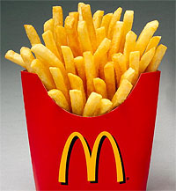
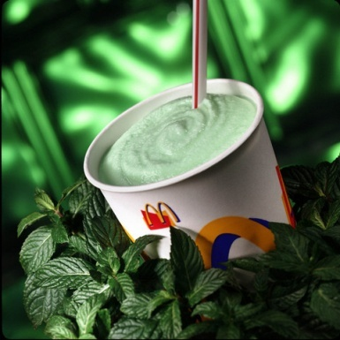
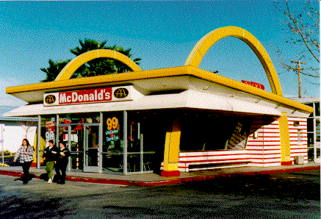
HISTORY
1949- French fries replaced potato chips and thick milk shakes were introduced
1955- a person named Ray Kroc took the franchise of Mcdonalds and opened a restaurant in Illinois. The attention getting red and white building with golden arches was designed by an architect named Stanley Meston
1956- Ray Kroc hires future chairman Fred Turneer to work as the counterman for Mcdonalds in des plaines

Slide 3
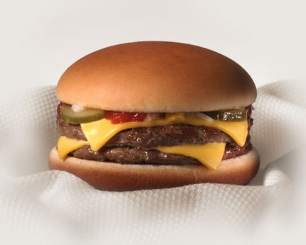
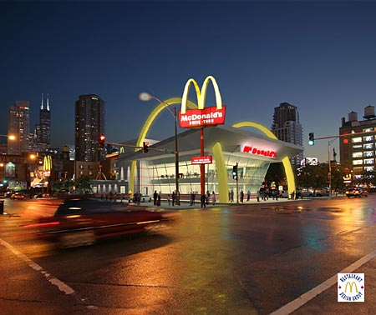
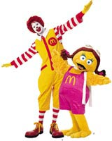
1958-Mcdonald’s sells it’s 100 millionth hamburger
1959-100th restaurant was opened in Fond du lac
1962- Indoor seating was introduced
1965-Mcdonalds introduced its first public stock offering
1966- Ronald Mcdonald appears in first television commercial

Slide 4


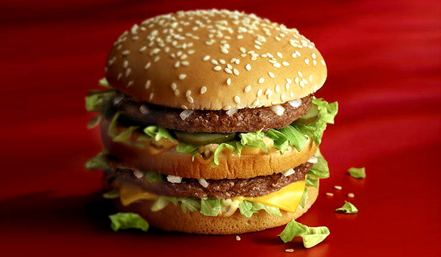
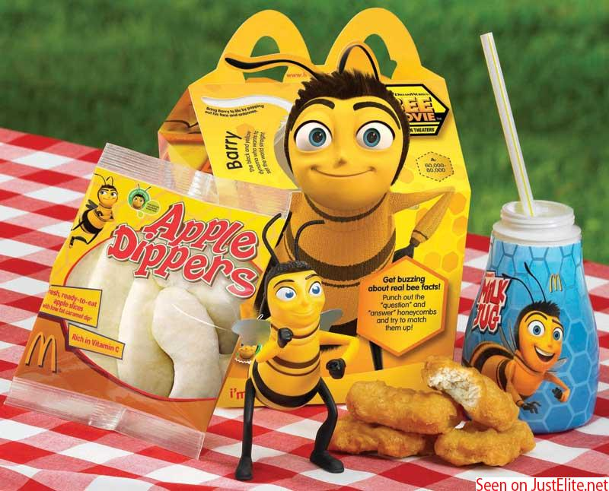
1967- Mcdonald opens it’s first international restaurant in Canada
1968- the big Macburger was introduced
1969- Mcdonalds underwent a major change, more emphasis was given on the golden arches
1979- Happy meals were introduced
1983- Mcdonald’s restaurants were opened in 32 countries

Slide 5
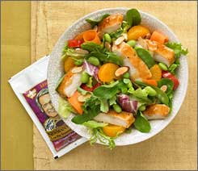
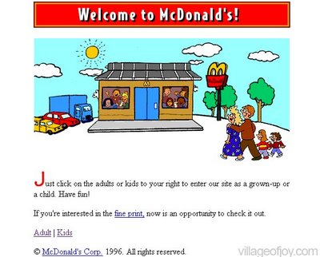

1984-Ray Kroc, the founder and the chairman of Mcdonalds died, and in the same year they introduced a new theme i.e it’s a good time for a great taste at Mcdonalds
1987- fresh salads were introduced by Mcdonalds for diet conscious people
1996- Mcdonalds.com was launched
1997- a new theme was added i.e did somebody say Mcdonalds

Slide 6
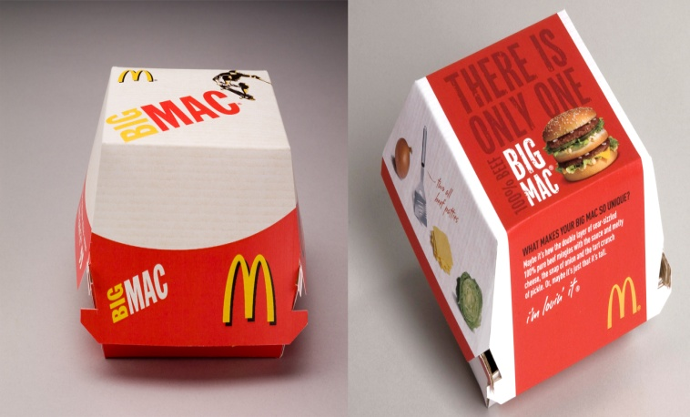
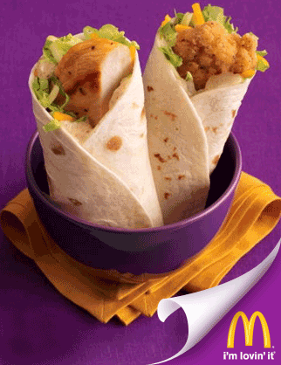
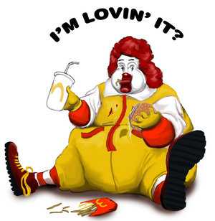
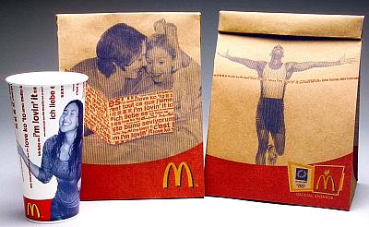
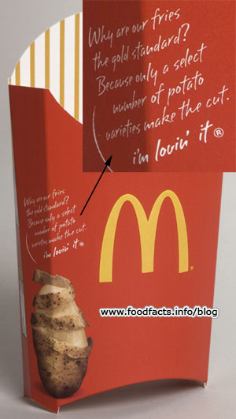
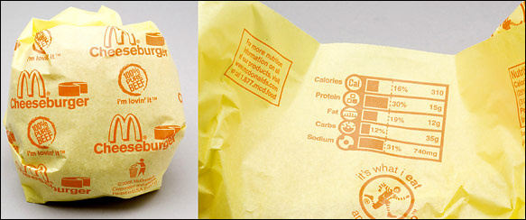
2003- Mcdonalds premium salads were introduced, and new theme i.e, I’m lovin’ it
2006- snack wraps were introduced by Mcdonalds
2007-new packaging by Mcdonalds

Slide 7


VISION
‘To be the best and leading
fast food provider around
the globe’

Slide 8
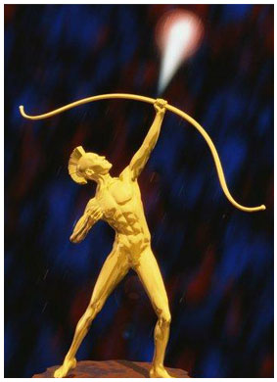

MISSION
"McDonald's vision is to be the world's best quick service restaurant experience. Being the best means providing outstanding quality, service, cleanliness, and value, so that we make every customer in every restaurant smile."

Slide 9
NUMBER OF STORES
McDonald's Corporation is the world's largest chain of fast food restaurants, serving nearly 47 million customers daily through more than 31,000 restaurants in 119 countries worldwide.
Of the 31377 McDonald’s restaurants around the world, 20505 (65%) are operated by franchisees, 3966 (13%) are operated by affiliates, and 6906 (22%) are company-operated.

Slide 10
NUMBER OF EMPLOYEES
1.5 million worldwide –
(398,000 company staff,1.1
million franchisee staff)

Slide 11
COMPETITIVE ADVANTAGE
McDonald’s success lies in its utilization of technology, routinization of work, and general deskilling of labor
McDonald’s bases its worker control and efficiency on one principle: worker stupidity.
McDonald’s implements the Frederick Taylor method of installing managers and a system of predetermined activities called task management.

Slide 12
McDonald’s goal is to maximize its profits including all devious means
McDonald's maintains its competitive advantage by constantly creating new items to add onto its menu
McDonald's also realized the changing world we live in and the need for healthier food

Slide 13
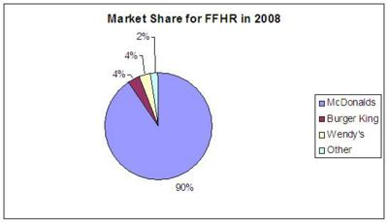
MARKET SHARE

Slide 14
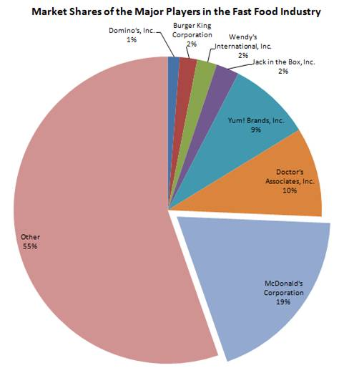

Slide 15
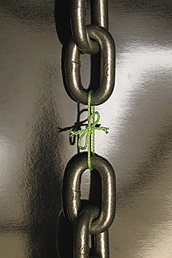


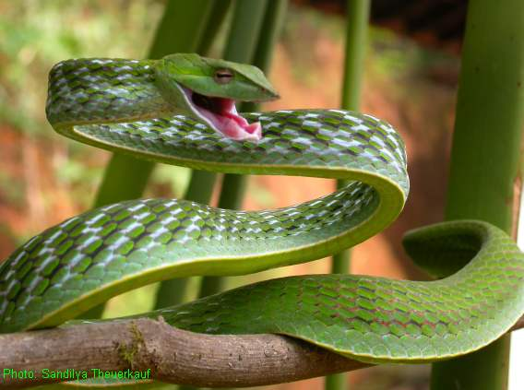
SWOT ANALYSIS

Slide 16

Strong brand name, image and reputation.
Large market share.
Strong global presence.
Specialized training for managers known as the Hamburger University.
McDonalds Plan to Win focuses on people, products, place, price and promotion.
Strong financial performance and position.
Introduction of new products.
Customer focus (centric).
Strong performance in the global marketplace.

Slide 17

Unhealthy food image.
High Staff Turnover including Top management.
Customer losses due to fierce competition.
Legal actions related to health issues; use of trans fat & beef oil.
Uses HCFC-22 to make polystyrene that is contributing to ozone depletion.
Ignoring breakfast from the menu.

Slide 18

Growing health trends among consumers.
Globalization, expansion in other countries (especially in China & India).
Diversification and acquisition of other quick service restaurants.
Growth of the fast-food industry.
Worldwide deregulation.
Low cost menu that will
attract the customers.
Freebies and discounts.

Slide 19

Health professionals and consumer activists accuse McDonald's of contributing to the country’s health issue of high cholesterol, heart attacks, diabetes, and obesity.
The relationship between corporate level McDonald's and its franchise dealers.
McDonald’s competitors threatened market share of the company both internationally and domestically.

Slide 20




PEST ANALYSIS

Slide 21
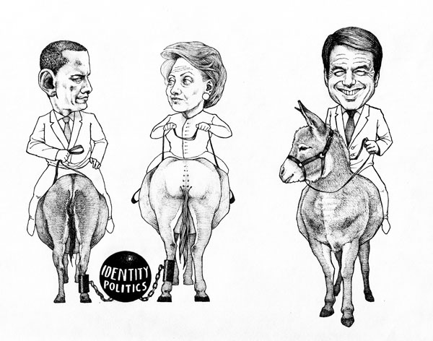
In general terms the government policies do not affect the company much nor do the
changes in the government influence the organization of the company.
McDonald’s enjoys an added advantage in countries
where consumer protection laws are not very strong
The international operations of McDonald’s are highly influenced by the individual state policies enforced by each government

Slide 22

Market leader.
Very high target market.
Low cost and more incomes.
The rate at which the economy of that particular state grows determines the purchasing power of the consumers in that country.

Slide 23

As McDonalds offer Hilal food majorly so there are no religious, ethical or cultural issues associated with the operations
For the rising importance of corporate social responsibility recently McDonald's has announced that it is giving further backing to Rainforest Alliance certification by offering a cup of tea with a conscience in all of its 1,200 restaurants in the UK.

Slide 24
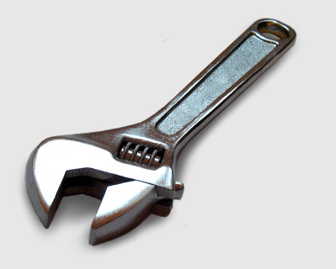
Food made with the help of machines is considered more hygienic.
However, the continuous developments in the technology sector needs McDonalds to be updated regularly.
It is natural that technology has helped McDonald and especially its employees as they have to serve quick services.
Computers and smart cashiers are used by the employees so they would not get confused and they are provided with customized database management system.

Slide 25
STAR QUESTION MARK
HIGH
STAR QUESTION MARK
CASH COW DOG
GROWTH RATE
LOW
HIGH
LOW
MARKET SHARE

Slide 26



Porter’s Generic Strategies Analysis
COST LEADERSHIP
DIFFERENTIATION
FOCUS

Slide 27

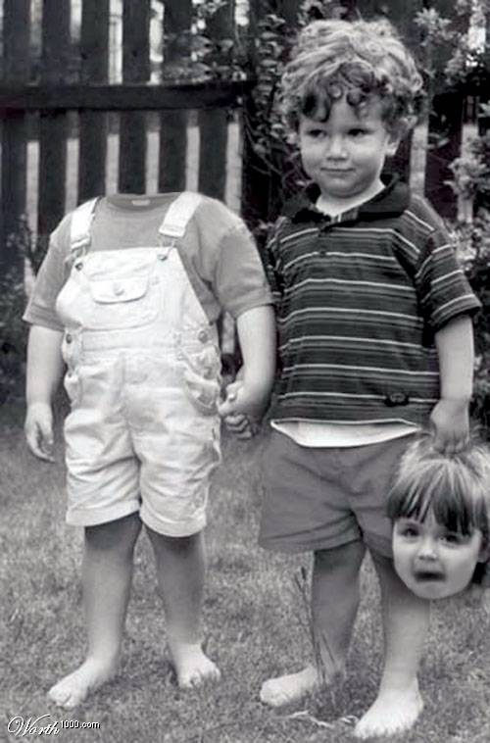

The Five Forces Model
Threat of New Entrants
Bargaining Power of Customers
Bargaining Power of Suppliers
Rivalry Among Existing Firms
Threat of Substitutes

